Slide 1

Flexible Retirement

Slide 2

The advantages of Flexible Retirement for an Employer
Flexible retirement was introduced into the LGPS in England and Wales from 6 April 2006 (18 Years Ago 😲)
Flexible retirement can:
help to avoid redundancies and the associated strain on Fund pension costs and redundancy payment / compensation costs
enable the employer to retain or attain a balanced age profile within the workforce
enable the transfer of skills / knowledge
offer the opportunity of better succession planning and mentoring
facilitate the retention of expertise and knowledge
offer the flexibility and productivity associated with part-time working
To offer this the Employer, needs a policy

Slide 3
The advantages of Flexible Retirement for an Employee
Flexible Retirement can -
Help ease down into retirement
Take your pension and continue to work so eliminate financial concerns

Slide 4
Eligibility for Flexible Retirement
Age 55 or over
The employer consents,
There has been a reduction in hours, and or
a reduction in grade.
The Employer must have a Policy

Slide 5
Flexible Retirement – how does it work
The 85-year rule automatically applies to flexible retirements (if the Scheme member is protected by the 85-year rule), even when the flexible retirement occurs before age 60.
If flexible retirement occurs before Normal Pension Age, the employer has the discretion to waive in whole or in part any actuarial reduction that would otherwise apply, if their discretions policy permits this.
The employer would meet the cost by making a strain on fund payment to the administering authority.

Slide 6
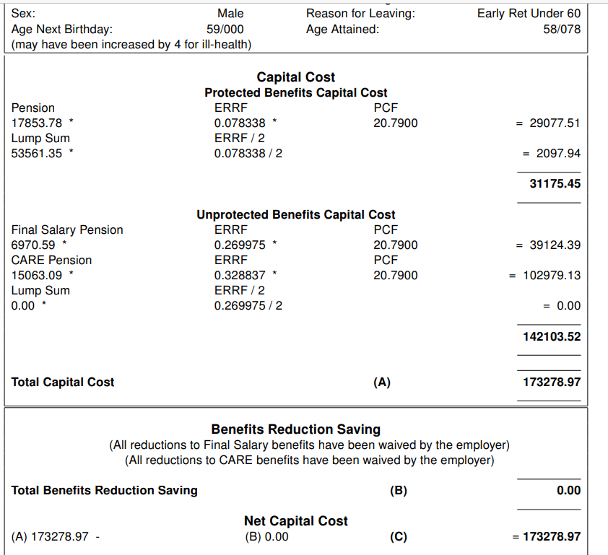
Flexible Retirement – determining the cost

Slide 7
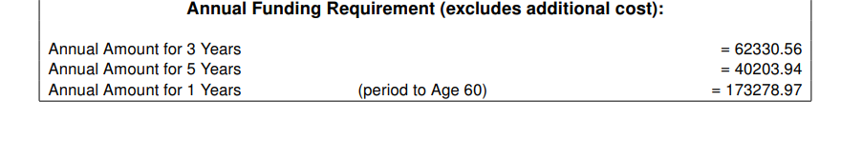
Flexible Retirement – determining the cost (continued)

Slide 8
The Process – Estimate
As Flexible Retirement is subject to employer’s approval, we are unable to provide estimates or confirm retirement on grounds of flexible retirement to a member directly. All requests must come from the employer. Staffordshire Pension Fund - All Employers (Except Staffordshire CC) (staffspf.org.uk)
The member should talk to their line manager and or their Human Resources Department to ask if an application for flexible retirement will be considered.
The employer will need to contact the Staffordshire Pension Fund to obtain the pension cost for early payment of your pension. It is important to always request an estimate
Only the cost will be sent back to the employer or confirmation that there will be no cost. If the Employer wants the member to see their pension figures you will need to let us know they need to be sent. Please note we cannot issue pension options without the approval of the employer.
Forms will be sent as part of the estimate that need to be completed for the actual Staffordshire Pension Fund - All Employers (Except Staffordshire CC) (staffspf.org.uk)

Slide 9
The Process – Actual
The employer will need to agree a date of the commencement of your flexible retirement.
The current period of pension service will end, but your employer will automatically enrol you into the Local Government Pension Scheme(LGPS) based on your new terms and conditions of employment. Forms are issued to the member should they wish to opt out of the LGPS in your new contract of employment
Confirmation of the Flexible Retirement and relevant pay details along with the members declaration and opt out form if applicable need to be sent to the us as soon as possible
A quote will be sent to the member within 15 working days of us receiving the completed paperwork
The payment of any lump sum will be paid within 15 working days of us receiving the completed paperwork back from the member.
Any Strain costs will be invoiced in accordance with the employer policy.

